Slide 1
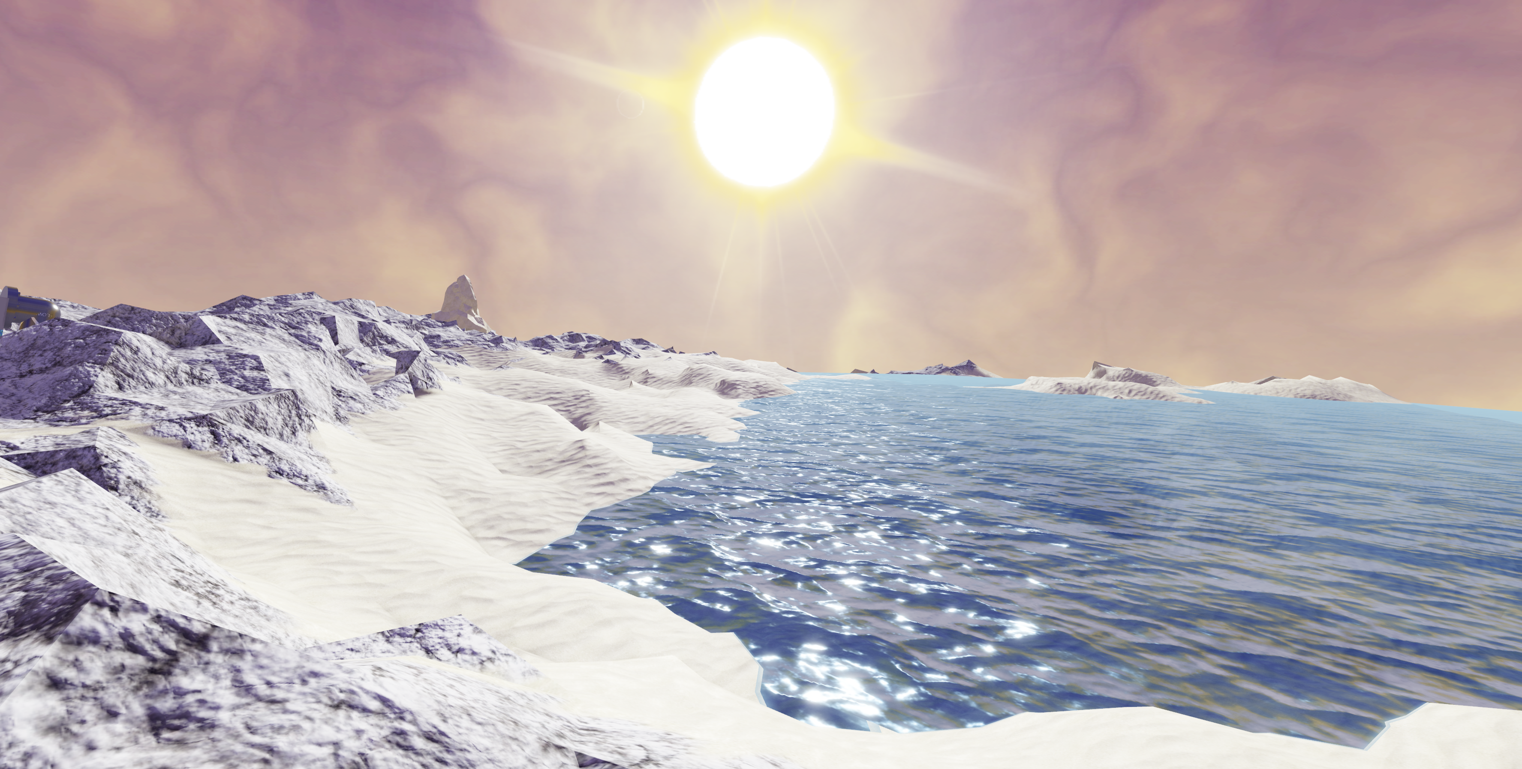
Planet Finder
A planet data search and display utility

Slide 2
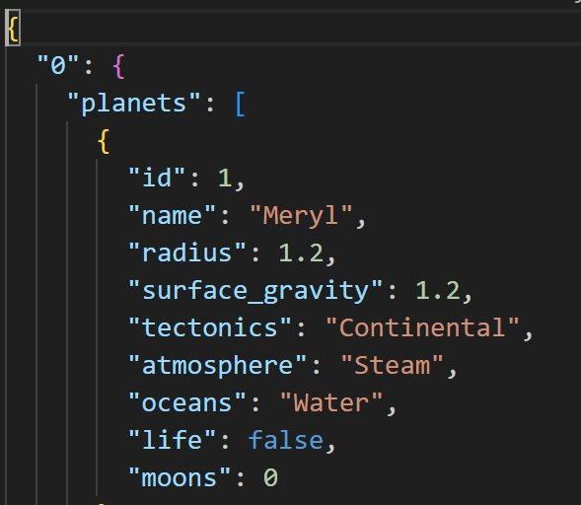
Core region dataset
Contains a dictionary of star systems each with a list of dictionaries which each represent a planet in that system.
This program focuses on the following keys. - tectonics - atmosphere - oceans - life

Slide 3
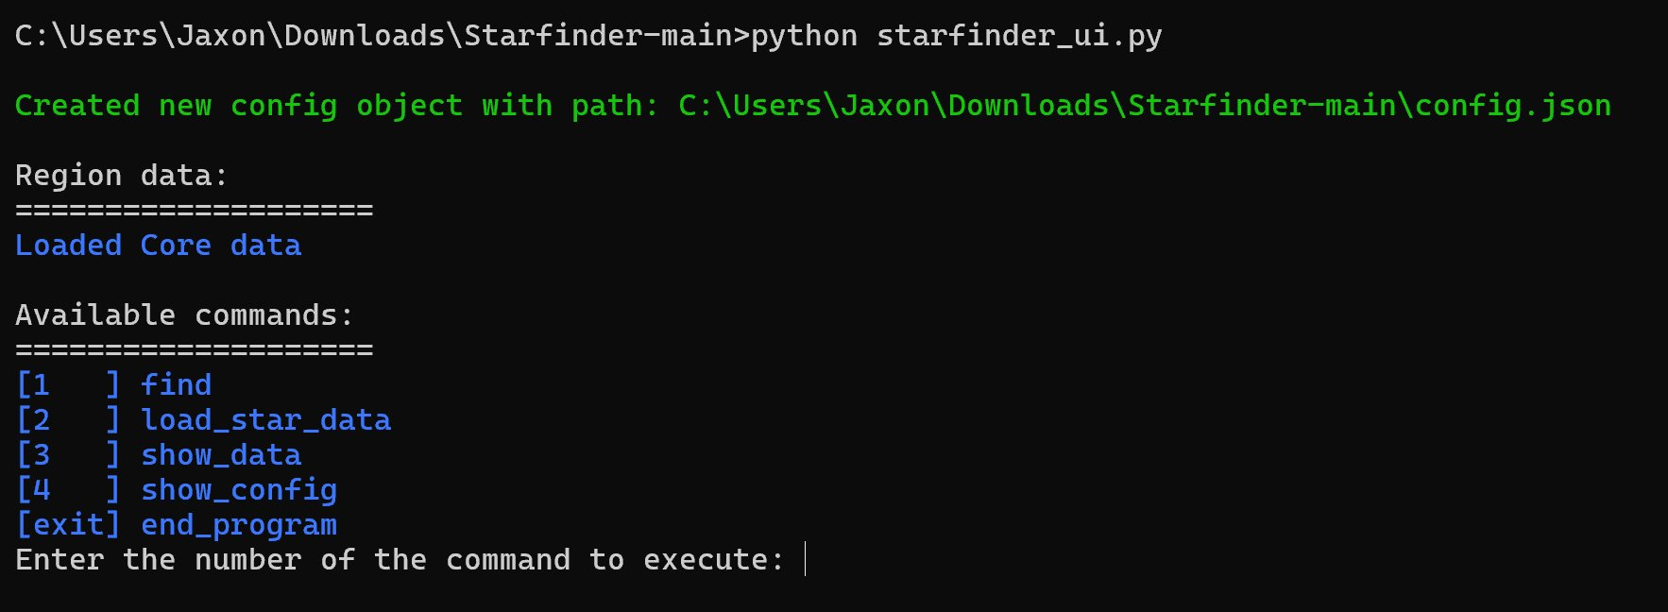
The main command prompting loop
Continuously prompts the user for commands until the user decides to exit the program. - find : Search for planets within the loaded data - load_star_data : Load in new data - show_data : Show summary of loaded data - show_config : Show current config structure - end_program : exit the program

Slide 4
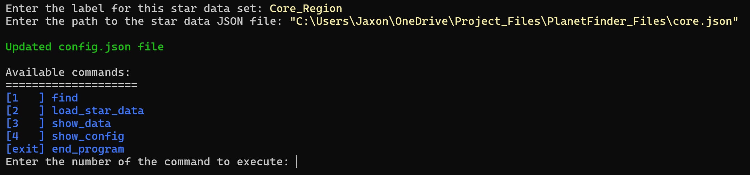
Loading in new data
To load new data the user types 'load_star_data' and enter.
Then they are prompted with a label and path to the data file.
Once completed the config object and Json file will be updated with the path and the nested dictionary will be loaded into the current usable data.

Slide 5
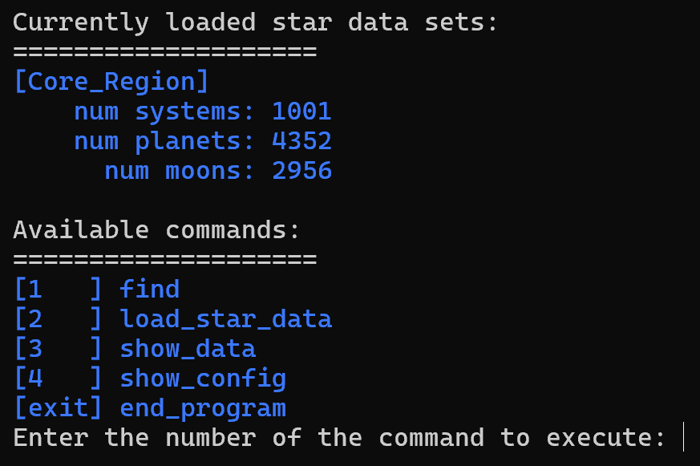
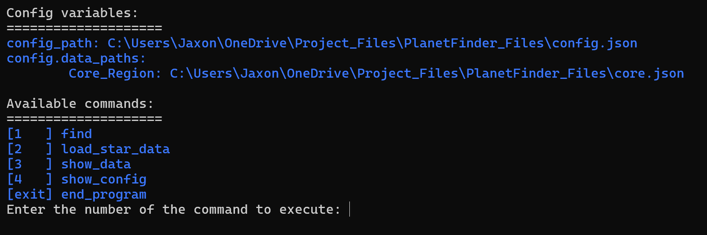
Examples of the 'show_data' and 'show_config'commands

Slide 6
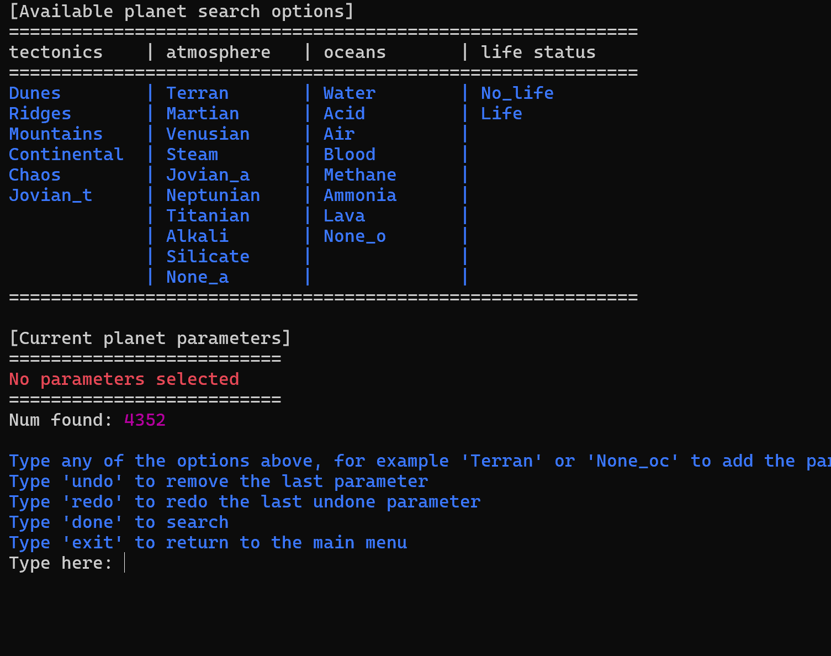
'find' function
Continuously prompts the user for new planet characteristic parameters.
Throughout the process the user is able to undo or redo the parameters they choose.
Then when they're ready to search they type 'done' and enter.
Or if they want to exit they type 'exit'.

Slide 7
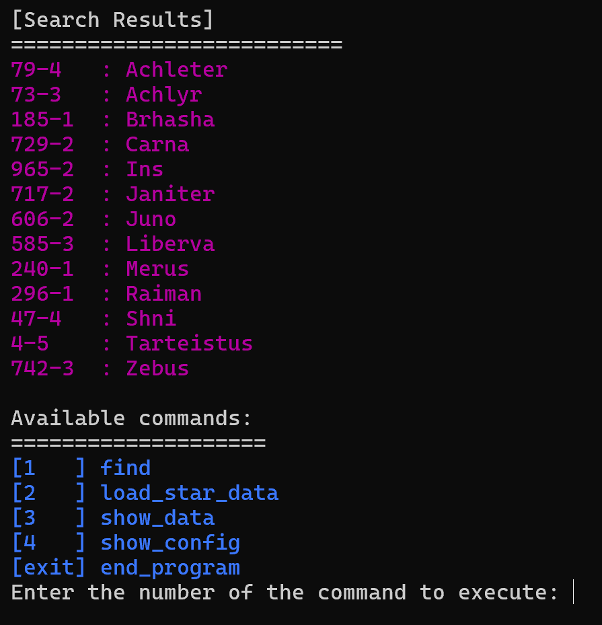
Search Results
Once the user types 'done' the program prints out the list of planet IDs which fit the parameters chosen
In this case the parameters were 'Continental', 'Terran', 'Water', and 'Life'

